Slide 1
SQL – JOINs (geo_ tables)
COMP-1701

Slide 2
In These Slides . . .
We will be covering:
A review of Tables relationships: Keys and ERD basics
JOIN ON Syntax:
Table prefixes (qualifying) and Aliases
Joining multiple tables
INNER vs OUTER JOIN (of which don’t specify them in your queries)
Alternative JOIN Syntax:
WHERE, NATURAL, USING, and CROSS JOIN

Slide 3
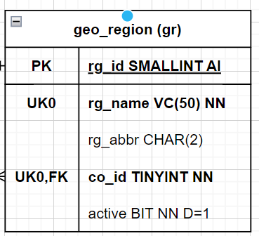
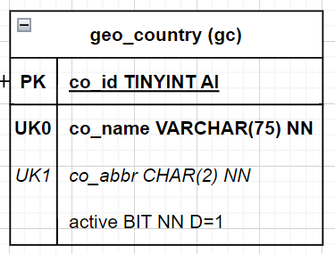
Multiple Tables
We have only ever used SQL to interact with a single table.
However, most meaningful SQL interactions involve the use of 2 or more tables at the same time.
For instance: What if we want to see a Country’s name beside the Region’s name on the same result row?

Slide 4
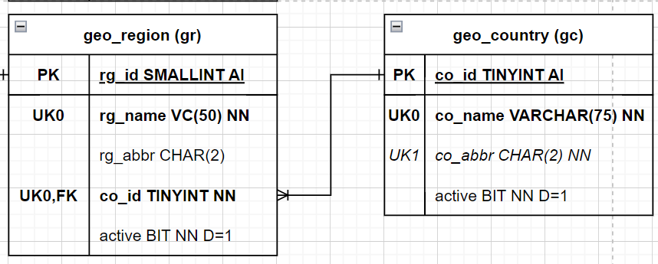
Table Relationships
Let’s review some basic table relationship before we write any SQL.

Slide 5
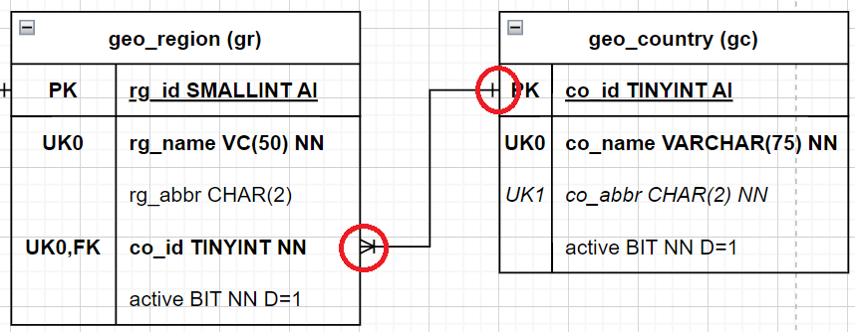
Table Relationships - ERD
All table relationships will have a line between a Primary Key (PK) and a Foreign Key [FK].
There exists a line between country and regions
Notice that one end of the line is on: PK co_id
The other line end is on: region_id [FK]

Slide 6
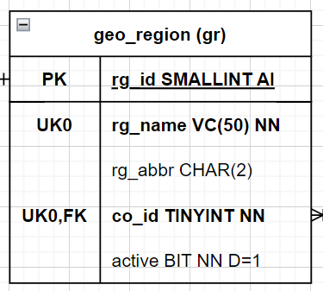
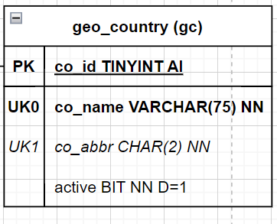
Primary Keys (PK)
Review:
Every table has a Primary Key (PK)
On the Regions table this is: rg_id
On the Countries table this is: co_id
Primary Keys must be UNIQUE and must not contain NULL values.

Slide 7
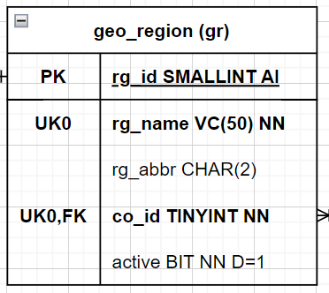
Foreign Keys [FK]
Review:
A Foreign Key [FK] is a column that references the primary key on another table.
The foreign key on the region table is: co_id [FK]
Do you remember which table is the Parent and which is the Child?

Slide 8

Parent - Child Table Relationships
Review:
The Child table always contains the Foreign Key [FK].
country is the Parent of region.
region is the Child of country.

Slide 9
JOIN ON - Syntax
Now that we have done a quick review of Primary/Foreign keys, let’s use some new syntax to JOIN the two tables together!
We will have two new keywords: JOIN and ON

Slide 10
JOIN ON - Syntax
Generic Syntax Example:
IMPORTANT: We must prefix (or qualify) a table name before a column_name, if the column names are the exact same on both tables. Clarifies which table the column is from.
SELECT a.column1, a.column2, …
b.column1, b.column2, …
c.column1, c.column2, …
FROM atable a
JOIN btable b ON a.PK_FK_col=b.FK_PK_col JOIN ctable c ON b.PK_FK_col=c.FK_PK_col;

Slide 11
JOIN ON - Syntax
SELECT tableA.column1, tableA.column2, …
tableB.column1, tableB.column2, …
FROM tableA
JOIN tableB
ON tableA.PrimaryKey=tableB.ForeignKey;
The ON keyword is always followed by a boolean expression which resolves to either TRUE or FALSE.
This is used to determine which rows end up in the result set.
IMPORTANT NOTE: the order does not matter, but for consistency you should write the Primary Key on the left side of the equal sign. Primary Key = Foreign Key.

Slide 12
JOIN ON - Syntax
SELECT tableA.column1, tableA.column2, …
tableB.column1, tableB.column2, …
FROM tableA
JOIN tableB
ON tableA.PrimaryKey=tableB.ForeignKey
WHERE …
ORDER BY column_name DESC;
You can use a WHERE and ORDER BY the same way that you always have.

Slide 13
JOIN ON - Example
How do we display the rg_name and cg_name in the same row? (For now, we will show all columns from all tables using the wildcard character: *)
The primary key and foreign key have the same name: co_id
We have to prefix (qualify) the table names in front because of that.
Note: country is the PARENT and therefore coding it as the second table, will show your FK and PK nearest to each other.
SELECT *
FROM geo_region grg
JOIN geo_country gco ON grg.co_id=gco.co_id;

Slide 14
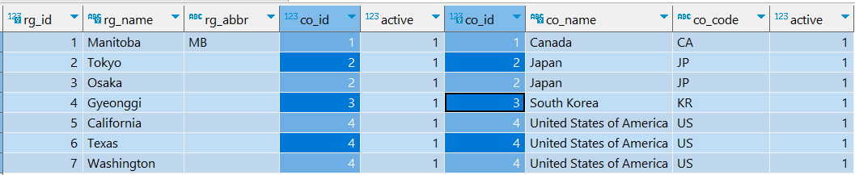
JOIN Order of Operations - Example
When joining these tables, the first row of Regions is compared against the first row of Countries.
If the ON condition resolves to FALSE, move to the next row. If the ON condition is TRUE, then both rows are merged into a single row and added to our result set:
In this case Manitoba’s co_id = 1, therefore it cannot be JOINed to Japan, as the record for Japan is 2:

Slide 15
JOIN - Prefixing/Qualifying Table Names
Let’s modify our code to prefix (qualify) the columns by their tables:
Note: We must qualify co_id with a table name (because it is the same on both tables). While not required - it is a good practice to qualify every column for consistency.
This does make for A LOT of text though.
SELECT grg.rg_id, grg.rg_name, grg.co_id
, gco.co_id, gco.co_name
FROM geo_region grg
JOIN geo_country gco ON grg.co_id = gco.co_id;
Notes:
region_id is the same column name in 2 columns, so it is ambiguous!

Slide 16
JOIN - Table Alias
Using an Alias is a great way to reduce text on your screen:
Notice that we have temporarily RENAMED our tables for this query:
Regions to the letter grg
Countries to the letter gco
Your alias name may be longer for clarity, but you’ll often see short names to reduce text.
SELECT grg.rg_id, grg.rg_name, grg.co_id
, gco.co_id, gco.co_name
FROM geo_region grg
JOIN geo_country gco ON grg.co_id = gco.co_id;
Notes:
The SQL here is the same as in the last slide. Also, yes, the declaration of the new alias name appears AFTER it is already used by columns, this may seem strange at first if you already have programming experience.

Slide 17
JOIN - INNER JOIN
There are several kinds of JOINs in SQL. The default JOIN we performed is called an INNER JOIN.
The keyword INNER in the above code is not necessary (it will work with it, but not advised to use it).
Later when learning LEFT/RIGHT OUTER JOINs, you then need to remove the INNER keyword, which is why it is best not to use it. JOIN on its own is an INNER JOIN.
SELECT grg.rg_id, grg.rg_name, grg.co_id
, gco.co_id, gco.co_name
FROM geo_region grg
INNER JOIN geo_country gco ON grg.co_id=gco.co_id;

Slide 18
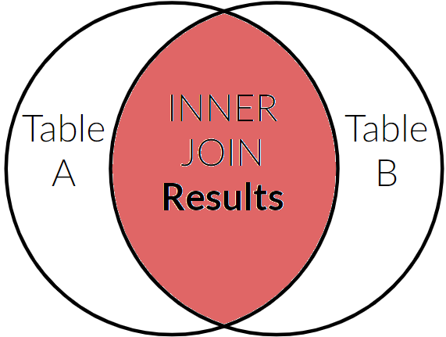
JOIN - INNER JOIN
The INNER JOIN will only show results where a match is made between two tables.
TableA is region.
TableB is country.
Results INCLUDE: Regions that have Countries
Countries that have Regions
EXCLUDED from results:
Regions with no Countries
Countries not assigned to a Region!

Slide 19
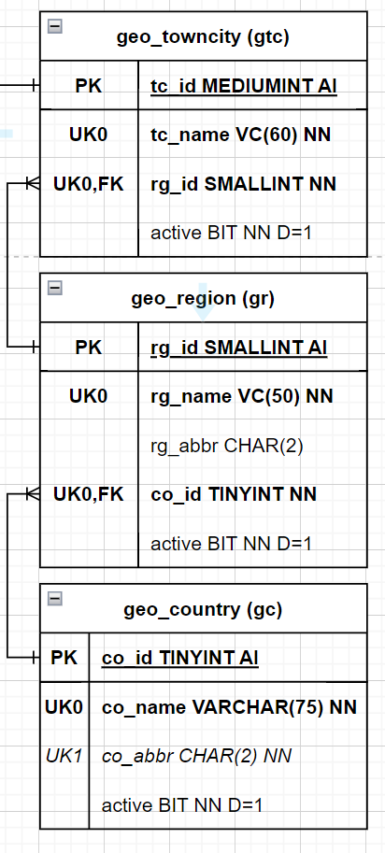
JOIN - INNER JOIN - Practice
TRY IT!
Add a JOIN to the existing query we looked at, and apply it, after the geo_towncity table’s definition.
The JOIN statement should list the geo_towncity before the geo_region, which in the current join the geo_region is before the geo_country.
geo_towncity’s FK of rg_id JOINs to the PK geo_region’s rg_id

Slide 20
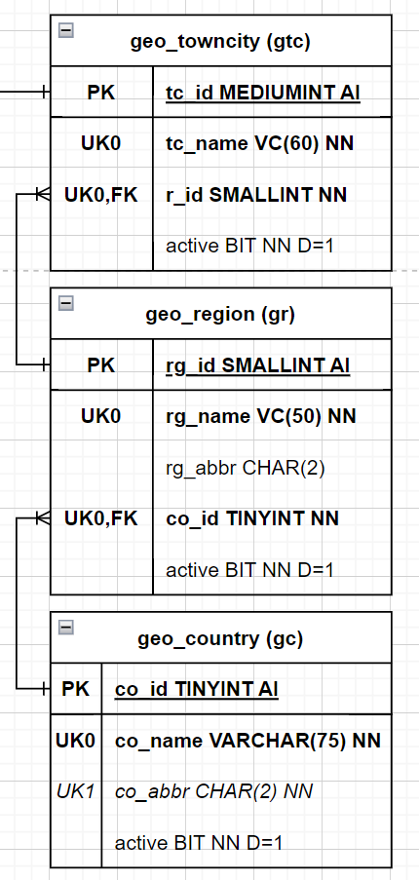
JOIN - INNER JOIN - Practice
SELECT gtc.tc_id, gtc.tc_name, gtc.rg_id
FROM geo_towncity gtc;
SELECT grg.rg_id, grg.rg_name, grg.co_id
, gco.co_id, gco.co_name
FROM geo_region grg
JOIN geo_country gco ON grg.co_id=gco.co_id;
Copy SELECT from geo_towncity query and FROM from geo_towncity, and place them above the lines in the second geo_region geo_country JOIN query.
SELECT gtc.tc_id, gtc.tc_name, gtc.rg_id
SELECT grg.rg_id, grg.rg_name, grg.co_id
, gco.co_id, gco.co_name
FROM geo_towncity gtc
FROM geo_region grg
JOIN geo_country gco ON grg.co_id=gco.co_id;

Slide 21
JOIN - INNER JOIN - Practice
Copy SELECT from geo_towncity query and FROM from geo_towncity, and place them above the lines in the second geo_region geo_country JOIN query.
Remove 2nd SELECT and replace with comma and 2nd FROM replace with JOIN
SELECT gtc.tc_id, gtc.tc_name, gtc.rg_id
, grg.rg_id, grg.rg_name, grg.co_id
, gco.co_id, gco.co_name, gco.co_abbr
FROM geo_towncity gtc
JOIN geo_region grg
JOIN geo_country gco ON grg.co_id=gco.co_id; --finish the JOIN ON statement to link rg_id's
SELECT gtc.tc_id, gtc.tc_name, gtc.rg_id
, grg.rg_id, grg.rg_name, grg.co_id
, gco.co_id, gco.co_name, gco.co_abbr
FROM geo_towncity gtc
JOIN geo_region grg ON gtc.rg_id=grg.rg_id
JOIN geo_country gco ON grg.co_id=gco.co_id;

Slide 22
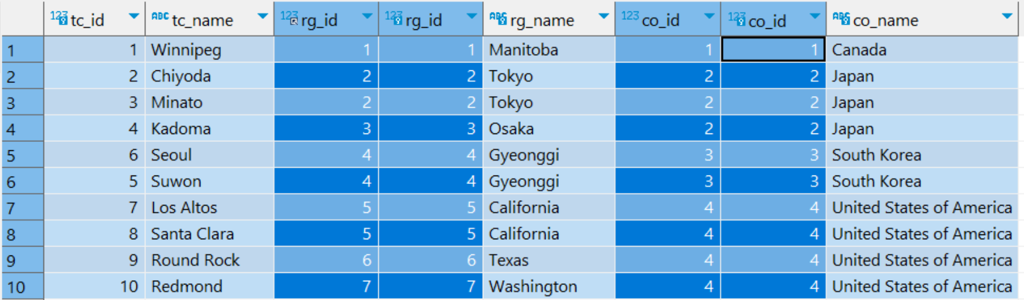
JOIN - INNER JOIN - Practice
SELECT gtc.tc_id, gtc.tc_name, gtc.rg_id
, grg.rg_id, grg.rg_name, grg.co_id
, gco.co_id, gco.co_name, gco.co_abbr
FROM geo_towncity gtc
JOIN geo_region grg ON gtc.rg_id=grg.rg_id
JOIN geo_country gco ON grg.co_id=gco.co_id;
-- now run the query
This example, would emulate the normal order you would see city, province, country on an envelope, usually gco.co_abbr, as usually the country is abbreviated. Next class we attach this to people.

